Slide 1
Loan Default Gramener Case Study
SUBMISSION
Team
Krishnan Raghupathi
Nanditha GN
Srividya Ravichandran
Abhijith N V

Slide 2
Key Objectives
Identify driving factors that influence loan default
Identify driver variables which are a strong indicators of default
Ensure that the inferences are
Data driven
Explained through visualizations
Inferences are made based on correct trends

Slide 3
What Data we have
Loan data for all loans issued through the time period 2007 to 2011from lending club
Loans rejected by lending club data is not available in the data set
Loans have 3 statuses
Fully Paid – Loans that are closed
Current – Ongoing loans
Charged Off – Loans that are defaulted by the customers
Few key columns and our understanding of those columns are listed in the next slide

Slide 4
Column Name | Explanation
collections_12_mths_ex_med | Number of collections in 12 months excluding medical collections. Can be ignored, mostly NA/0 values
funded_amnt | Amount that was funded by the investors. In few cases this will be lesser than the Loan Amount, the remianing amount is problably lent by LC dirctly
int_rate | Interest Rate on the loan
last_pymnt_amnt | Last total payment amount received. This will be 0 for Charged off
last_pymnt_d | Last month payment was received
loan_status | Current status of the loan
mths_since_last_major_derog | Months since most recent 90-day or worse rating
mths_since_last_record | months since the last (derogatory) public records
open_acc | The number of open credit lines in the borrower's credit file. Ranges from 2 - 44
out_prncp_inv | Remaining outstanding principal for portion of total amount funded by investors
pub_rec | Number of derogatory public records.Another piece of data Lending Club provides is the number of public records on file. This is pulled from the credit report, so don’t confuse it with criminal public records. Credit report public records are things like bankruptcy, foreclosure, tax liens, and past-due child support.
recoveries | Recovery after defauls
revol_util | Revolving line utilization rate, or the amount of credit the borrower is using relative to all available revolving credit.
sub_grade | The majority of loans is either graded as B or C — together these correspond to more than 50% of the loan population.While there is a considerable amount of A graded or “prime” loans (~17%), there is a small amount of G graded, or “uncollectible” loans (~0,06%).
term | loan term. Only 2 term is available 36 months and 60 months
total_pymnt | Payments received to date for total amount funded
total_rec_int | Interest received to date
verification_status | Not verified, Verified (by LC) and Source verified are the options

Slide 5
Data cleaning
Column Name | Explanation
earliest_cr_line | Converted tot date time. Correcting dates in future to 1900 dates
issue_d | Converted tot date time
last_credit_pull | Converted tot date time
last_pymnt_d | Converted tot date time
next_pymnt_d | Converted tot date time
int_rate | Stripped % text and converted to float
revolv_util | Stripped % text and converted to float

Slide 6
Data we derived
Available column
Reason
DTI Bin
Derived Columns
DTI
To understand patterns by specific bins
Revolving Utilization
Interest rate
Revolving Utilization
Interest rate
Available column
Reason
Annual Income Bin
Derived Columns
Annual Income
Annual Income bins to understand patterns by specific bins
Loan Default
Loan Status
Loan Default will have 1 for Charged Off and 0 for Fully Paid and Current. This will help in aggregating data

Slide 7
Analyses & Inferences

Slide 8
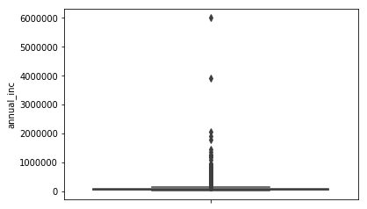
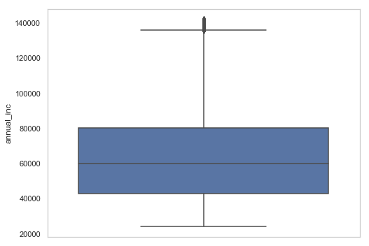
Univariate and outlier Analysis
Annual income distribution – With all data
Annual income distribution – removing outliers
Univariate and Outlier analysis was performed on all important value columns and appropriate percentiles were taken to remove the outliers
Annual income graphs are shown abov
Similar exercise was done for
Instalment 4) funded_amnt
DTI 5) Interest rate
Revol_bal 6) Loan Amount

Slide 9
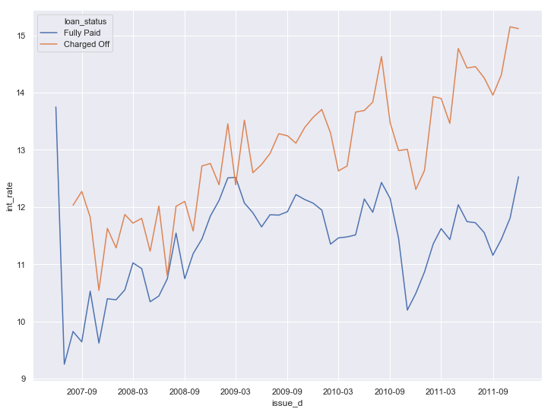
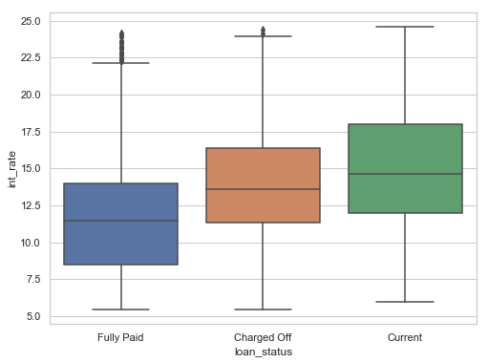
Rate of interest impact
Observations:
Rate of interest for fully paid is consistently lower compared to charged off/default over the years
Median of interest rate is higher for charged off compared to Fully paid
Post 2010 the gap is significantly higher
Inferences:
Higher rate of interest are guided by high risky loans
People with lower grades tend to get higher rate of interest
This risk factor leads to charged off

Slide 10
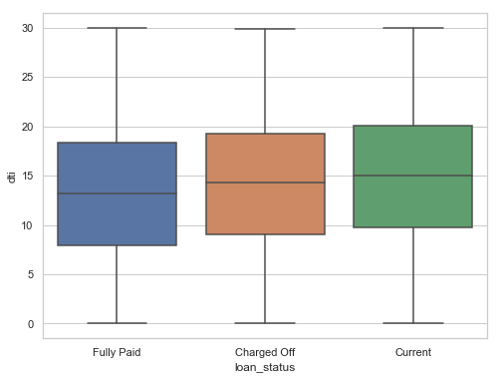
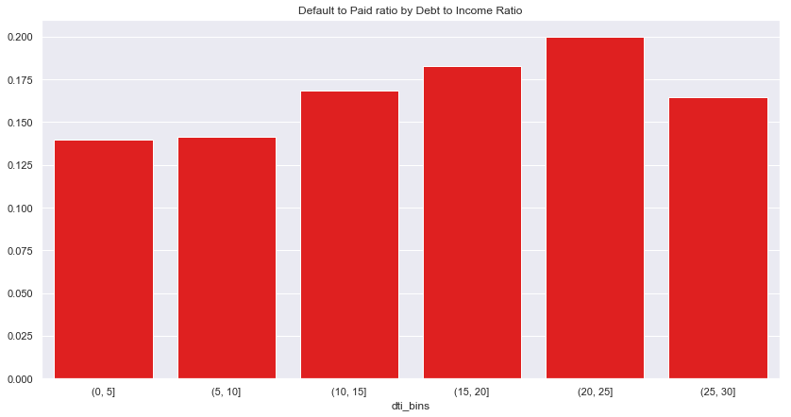
Debt to income ratio impact
Observations:
DTI is higher for charged off compared to fully paid
Charged off count to Fully paid count ratio is highest in the 20-25 DTI Bin
Inferences:
Higher the debt to income ratio there is a high risk of people defaulting on the loan

Slide 11
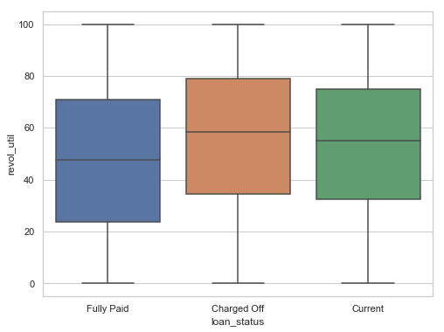
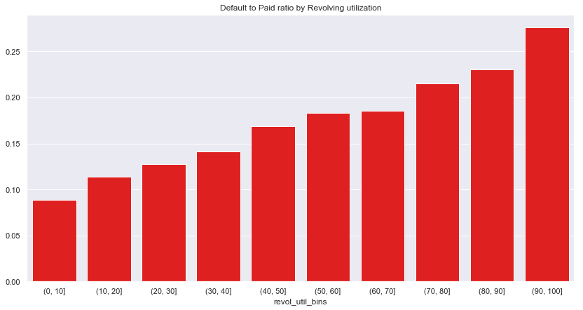
Revolving utilization percentage impact
Observations:
Revolving Utilization %ge is higher for charged off compared to fully paid
Charged off count to Fully paid count ratio is increases as Revolving utilization %ge increases
Inferences:
Customers having higher revolving utilizations have a high risk of defaulting on the loan

Slide 12
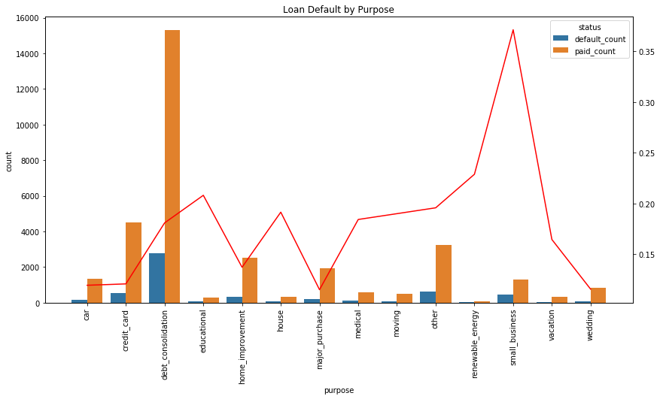
Loan purpose impact
Observations:
Debt consolidation has the highest loan applications are for
Small Business has the highest default percentage followed by renewal energy
Inferences:
People take loan with better rate to consolidate their loans
Small business have high risk of failure, hence loan default is also quite high
* Red trend line shows the Charged off count to Fully paid count ratio. This is a good indicator of the likely hood of default

Slide 13
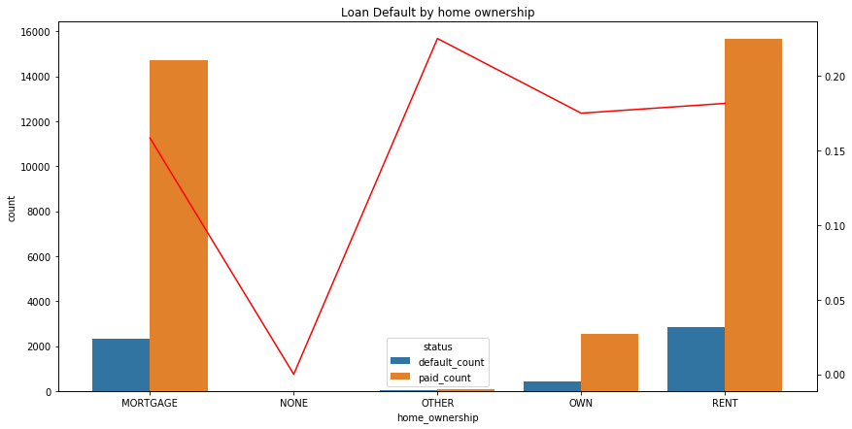
Home ownership impact
Observations:
Mortgage and rent have the highest loans given
Between mortgage, rent and own, rented and own home owners tend to default more compared to Mortgage
Although not many loans under others, it has a significant percentage of loan defaulting (>20%)
Inferences:
Others is an undefined category, need more data to understand why it has more defaults
Mortgage has lower percentage of default. Since mortgage is a major loan and any default on other loan will increase the RoI or loan category, hence Mortgage owners tends to pay back and have a less risk of defaulting
* Red trend line shows the Charged off count to Fully paid count ratio. This is a good indicator of the likely hood of default

Slide 14
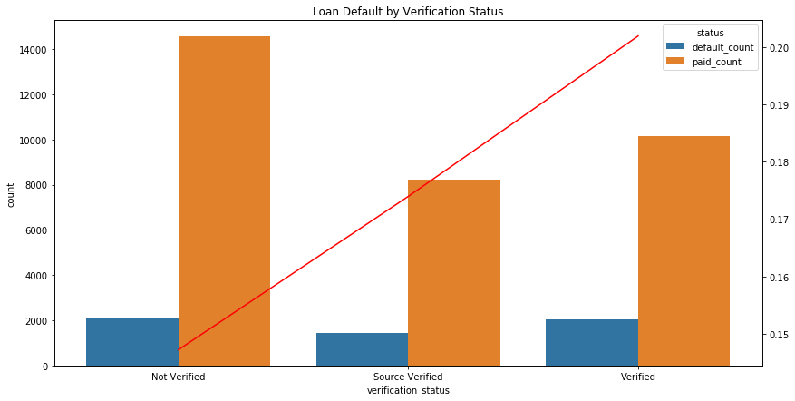
Verification status impact
Observations:
Highest loans are given without any applications verification
Verified loans have the highest default percentage
Inferences:
Verification process need to be relooked into to see what are the reasons for default even after verification
* Red trend line shows the Charged off count to Fully paid count ratio. This is a good indicator of the likely hood of default
Notes:
Change the title

Slide 15
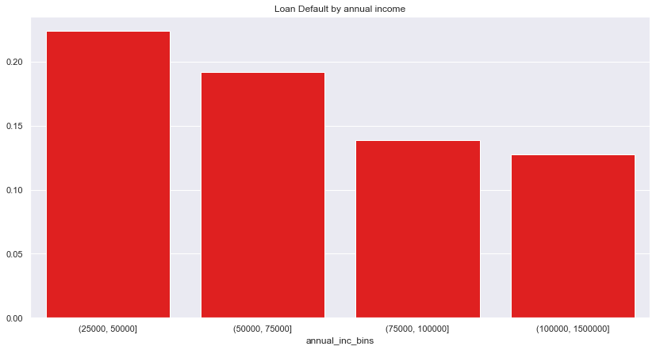
Annual income impact
Observations:
Higher the income rate lower the chance of default
Inferences:
People on higher income bracket tends to default less
Notes:
Change the title

Slide 16
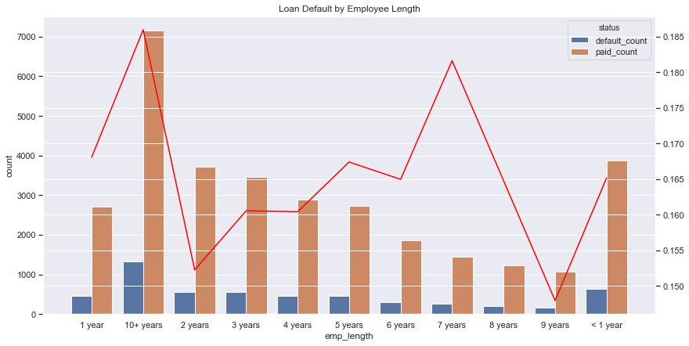
Employment length impact
Observations:
Higher defaults are with people who have higher employment length 10+ years
Less than 5 years tends to haave lesser default
Inferences:
* Red trend line shows the Charged off count to Fully paid count ratio. This is a good indicator of the likely hood of default
Notes:
Change the title

Slide 17
Conclusions – Driver Variables for Loan Default
Interest Rate
DTI : Debt to Income Ratio
Revol Util: Revolving Utilization %
Home Ownership
Higher interest rates are having higher charged off
Since interest rates are derived by grades and subgrade, higher risk grades needs to be monitored for charged off
Higher the debt to income ratio there is a high risk of people defaulting on the loan
Customers having higher revolving utilizations have a high risk of defaulting on the loan
People take loan with better rate to consolidate their loans
Small business have high risk of failure, hence loan default is also quite high
Verification Status
Loan purpose
Mortgage has lower percentage of default. Since mortgage is a major loan and any default on other loan will increase the RoI or loan category, hence Mortgage owners tends to pay back and have a less risk of defaulting
Others is an undefined category, need more data to understand why it has more defaults
Verification process need to be relooked into to see what are the reasons for default even after verification
Annual Income
People with higher annual income have lesser default rate

